Slide 1
CHATBOT ACADEMY
SOLUTIONING TRACK

Slide 2
Course outline
A MESSAGE FROM OUR
SPONSOR
Shannon Gilbertson
MODULE 4:
DIGITAL BEHAVIOR
Patrick Leinen
MODULE 1:
EXPERIMENTATION
Tammy Kruszewski
MODULE 5:
STARTING THE CONVERSATION & SOLUTIONING
Matthew Pope
MODULE 2:
CHATBOT INTRODUCTION
Dujon Smith
MODULE 6:
REFERENCE ARCHITECTURE
Matthew Pope
MODULE 3:
CHATBOT LANDSCAPE &
USE CASES
Dujon Smith

Slide 3
Module 1: CHATBOT EXPERIMENTATION

Slide 4
experiment & share
INSURANCE BOT
STU
COBE
BYOBot
Go here to test out our Insurance Bot!
Sample questions can be found on the page.
Send a text message to 847-603-2472 and ask some questions to Stu about our Operations Studio!
Sample questions:
Where is the Ops Studio located?
How do I book a client visit to the Studio?
Do I need a security badge?
Check out the Code Of Business Ethics chatbot, COBE.
Sample questions:
What is the policy for gift giving?
What are the five G&E criteria?
How can I use social media?
Participants will share experiences with a ‘bot’ of their choosing from the pre-work activities.
Why did you choose this bot?
How does this bot make you feel when interacting with it?

Slide 5
Module 2: chatbot introduction

Slide 6
What is a chatbot?
MESSAGING DRIVES THE CHABOT CHARGE
A chatbot is a digital service that can hold natural conversations with human beings with the aim of accomplishing particular tasks, such as answering questions or enabling product purchases. Our Accenture Virtual Assistant team’s perspective defines a chatbot as being powered by a set of business rules (Work Complexity) and varying degrees of AI (Knowledge Complexity) wherein these bots converse with real people via omni-channels such as text, voice, social.

Slide 7
Chatbot evolution
1966
ELIZA
1988
JABBERWACKY
1995
A.L.I.C.E.
2006
IBM’S WATSON
2012
GOOGLE NOW
2015
CORTANA
2016
TAY
Mimicked human
conversation by scripted responses.
One of the earliest attempts AI through human interaction
Artificial Linguistic Internet Computer Entity natural language processing.
Natural language and machine learning to process data
Natural language user interface to answer questions and perform actions
An intelligent assistant that sets reminders, recognizes natural voice and answers questions
Microsoft’s ChatBot Tay designed to mimic a teenage American girl.
2016
Facebook Messenger
1972
PARRY
1992
DR. SBAITSO
2001
SMATERCHILD
2010
SIRI
2015
ALEXA
Simulated a
person with paranoia: “Eliza with
Attitude”.
Intelligent bot with features - quick data access and fun personalized conversation.
Intelligent personal
assistant, featuring a natural language UI to answer questions and perform Web requests.
Voice service inhabiting Amazon Echo, Alexa is capable of voice interaction processing algorithms to receive, recognize, response
Messenger platform which allows devs. to create Chatbots that can interact with FB users (June, 11.000 ChatBotswer).
AI speech synthesis
program created for MS DOS-based PCs - far from lifelike.

Slide 8
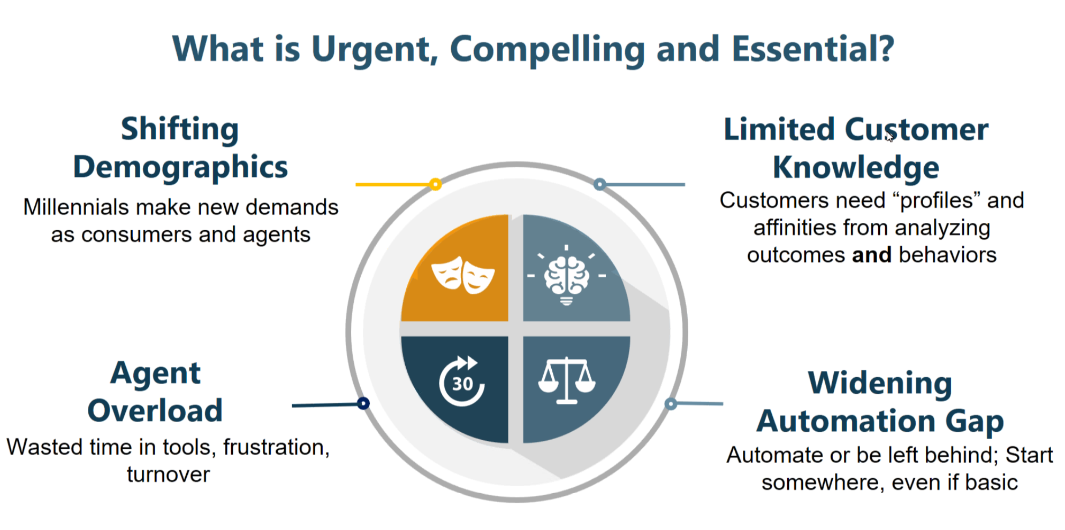
Starting the conversation
Notes:
Source: NanoRep / Accenture session 12/6 & 12/7, 2017

Slide 9
Module 3: chatbot landscape & use cases

Slide 10




CHATBOT landscape
High level make-up of a chatbot-based application
Omnichannel
Front End
COGNITIVE
SERVICE
Knowledge Management
The messaging app is the means of the system, the infrastructure.
It allows the bot to:
Receive the data
Provide user experience & user interface
Deliver the actual output (an answer, an order, other assistance, etc.
The AI is the core of the system, the services
It allows the bot to:
Understand inputs
Perform required tasks
Make task output understandable
Company’s proprietary database of customers, data, products, etc.
It can be leveraged in order to:
Allow training of the AI engine
Retrieve customer information
Perform omni-channel integration

Slide 11
CHATBOT continuum
Deep complex relationships
Cognitive Concierge
Order Concierge
Provider Concierge
Professional
Advisors
Employee Concierge
Collection Concierge
Legal/Contract Advisors
KNOWLEDGE
COMPLEXITY
Regulatory Compliance Advisors
CPA Advisors
Virtual
Assistant
Tech Support Assistant
Basic
Chatbot
Customer Support Assistant
FAQs
Basic 101
Shallow simple relationships
Factoid, question, little or no discretion
WORK COMPLEXITY
Complex case,
Judgement-oriented

Slide 12
CHATBOT continuum
Inputs
Interaction Models
Knowledge & Work Capabilities
Chat, proactive notifications/alerts, information, speech recognition & speech synthesis, NLG, NLU, dialog manager
Basic Chatbot
Upload Q&A pairs
Chat
Upload Q&A pairs, curated corpus of knowledge, AI training
Open Knowledge Domain, All of the above + emotion detection and generation, intent detection, planning
Virtual Assistant
Chat or voice
Closed/Specialized Knowledge domain, agent assist, context augmentation, transaction processing, complex workflow processing, API integration, Robotic Process Automation (RPA)
All of the above + machine learning
Chat or voice w/non-human avatar
Professional Advisor
Cognitive Concierge
Upload Q&A pairs, curated corpus of knowledge, AI training, machine learning.
Chat or (biometric) voice w/human avatar.
All of the above + personalization engine, intelligent case management, abductive reasoning engine

Slide 13
BPS procurement AI Strategy
Deep,
complex relationship
Procurement
Helpdesk
Assistant
Supplier Intelligent Advisor
Category Intelligent Advisor
Sourcing
Intelligent Advisor
Buyers
Concierge
KNOWLEDGE
COMPLEXITY
Knowledge Management / Substrate
Shallow,
ssimple
rrelationship
Factoid, question, little or no discretion
WORK COMPLEXITY
Complex case,
Judgement-oriented

Slide 14
BPS Use Cases
Finance & Accounting
Procurement
Health
Supply Chain
Talent & HR
Marketing
Credit Services
Infrastructure Services
Multi-Offering
OTC Cash Application
Intelligent Invoice
Invoice Status
Intelligent Order
RTR JE & Reconciliations
T&E Analytics
Financial Services: Collette Mortgage Advisor
Procurement Helpdesk Assistant
Procurement Market Intelligence Advisor
Predictive Compliance Advisor
Predictive Spend Categorization
Supplier Intelligence Advisor
Claims Adjudication Assistant
Health Care Pre-Authorization Advisor
Life sciences:
Pharmacovigilance Advisor
Warranty
claims
Resume
screening
advisor
Image content moderator
Lease Abstraction Advisor
Lease Extraction Advisor
Intelligent Alerts Advisor
Cyber Security Threat Advisor
Intelligent Email Advisor
Category Intelligence Advisor
Quote Configurator
Seana
SAP Bill
Sam Conference Assistant

Slide 15
Module 4: digital behavior

Slide 16
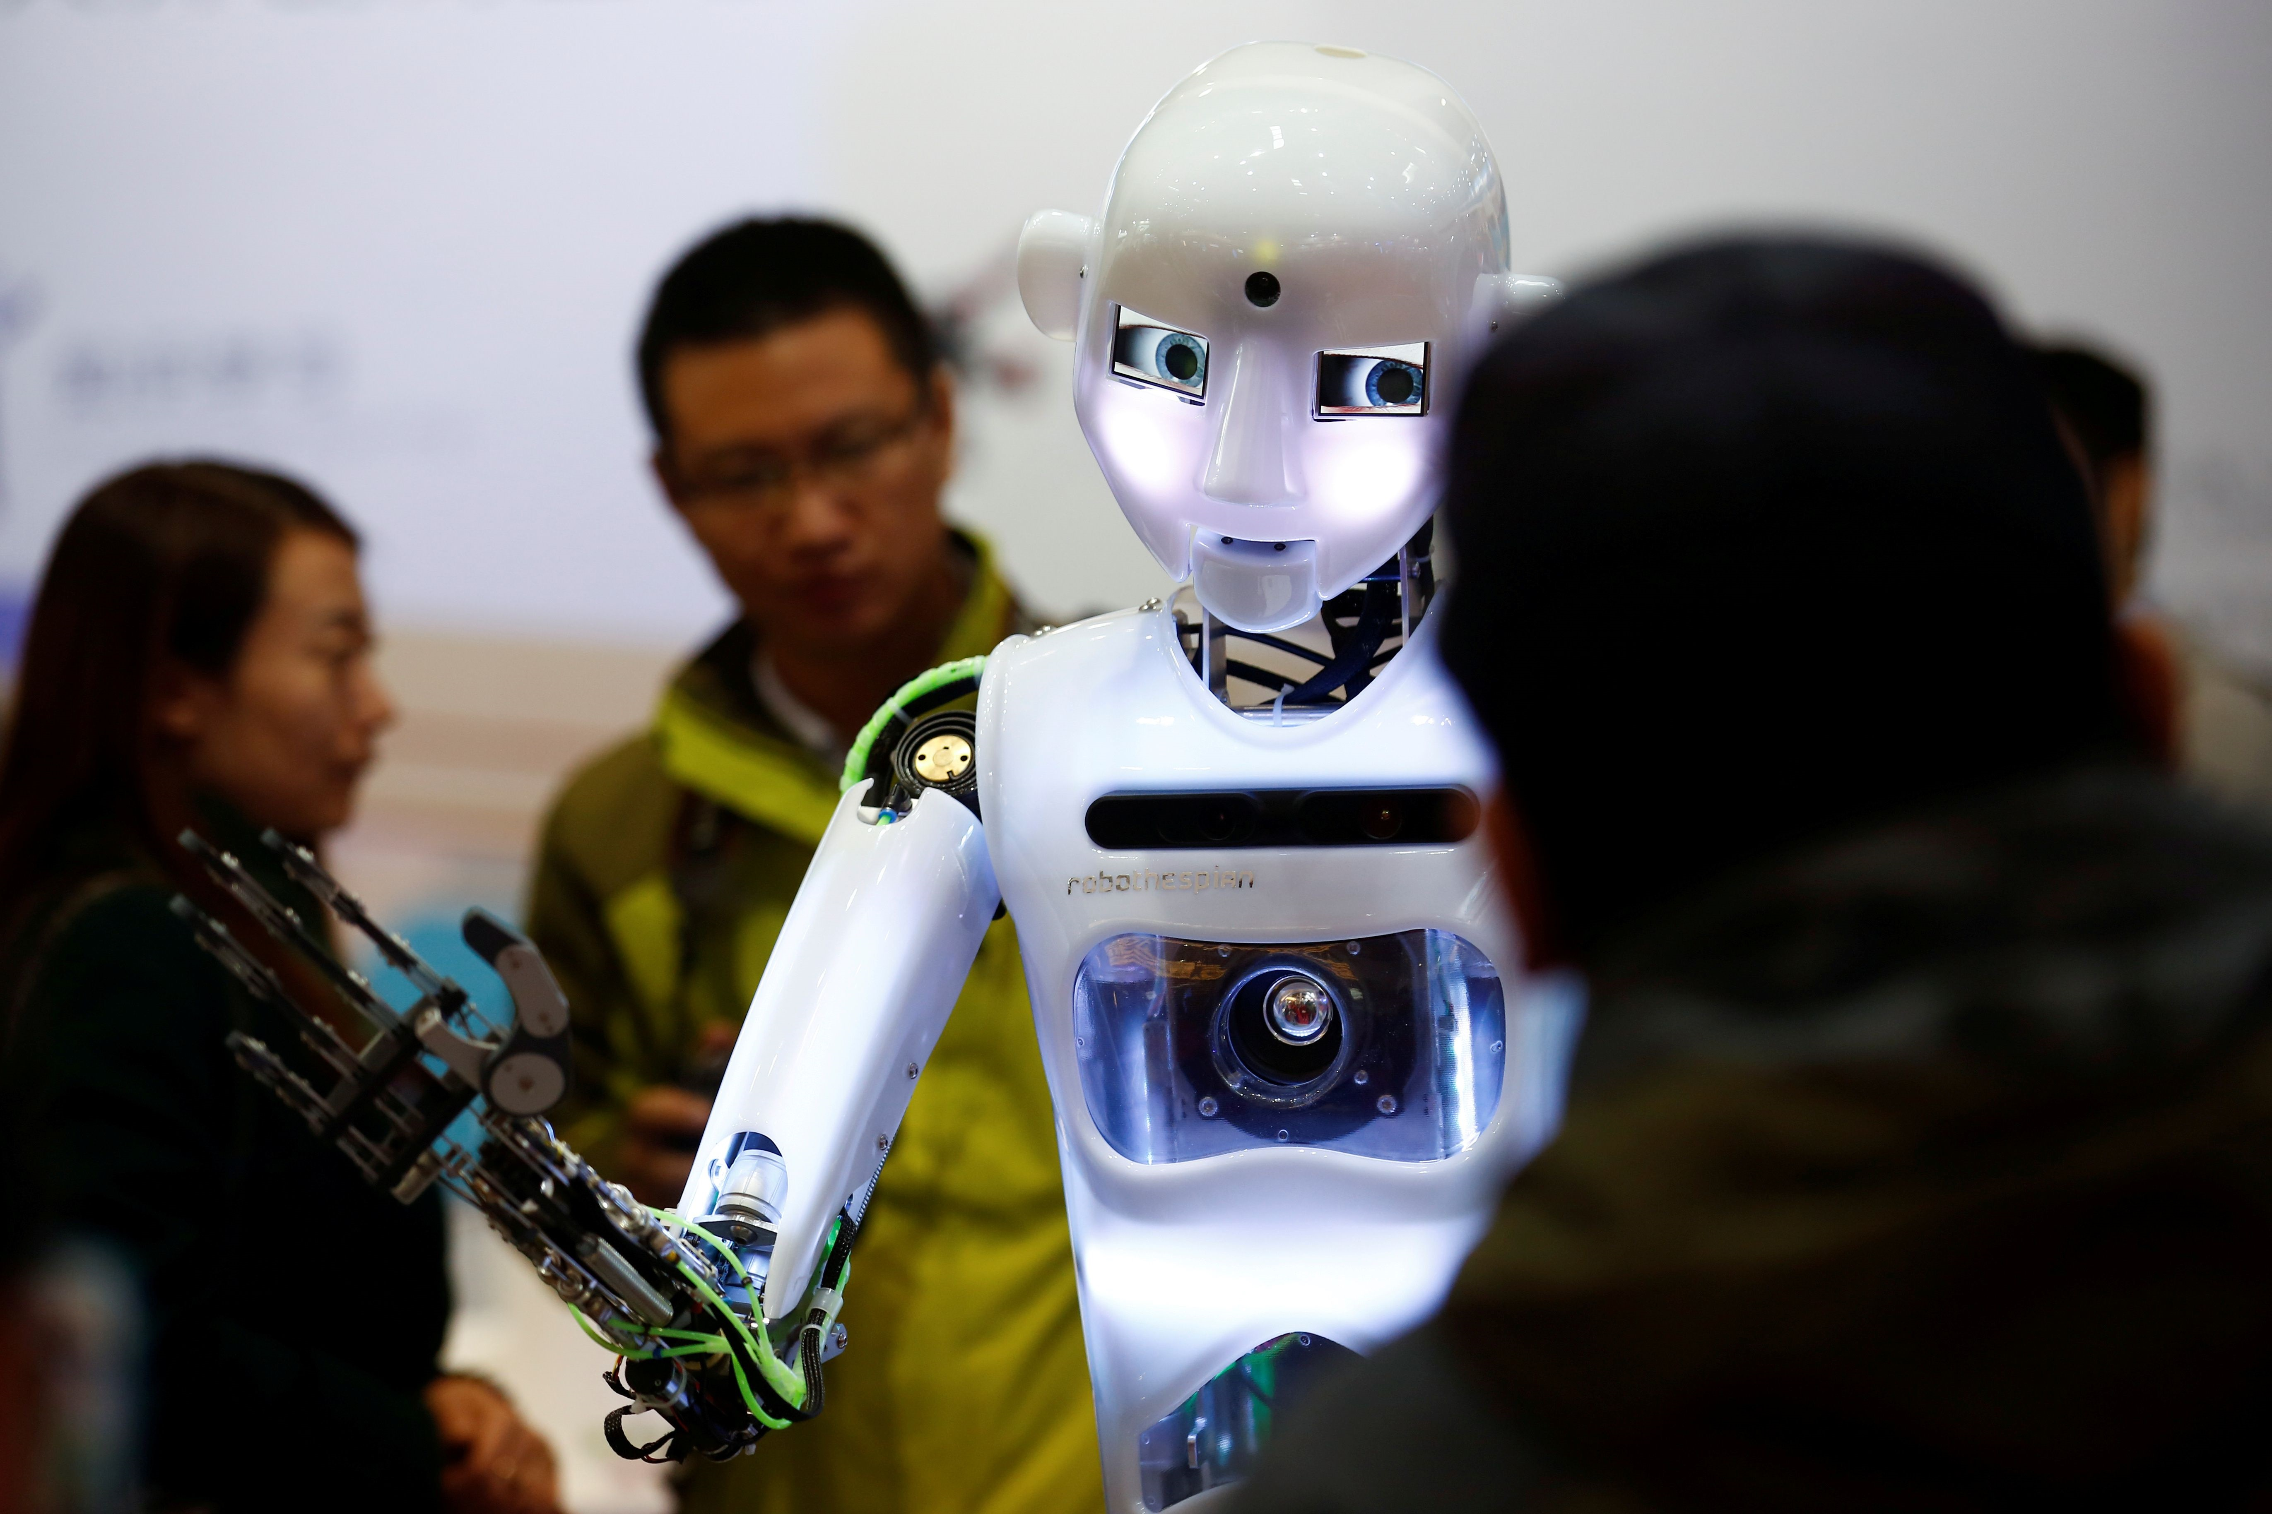
DIGITAL BEHAVIOR
USER EXPERIENCE IS PARAMOUNT
When human beings interact with technology, psychological and emotional responses are triggered. The experience must leave the customer feeling confident, trusting, informed and fulfilled. Thus, the design of a chatbot, which is mimicking human interaction, must be done with care and consideration.
Reeves, B. & Nass, C. (2003). The media equation: how people treat computers, television and new media like real people and places: University of Chicago Press: New Ed. Edition.
Notes:
Based on the work of Nass who studied how people interact with new media, computers, and television. What he learned was that people interact with technology in many of the same ways they react to human interactions.

Slide 17
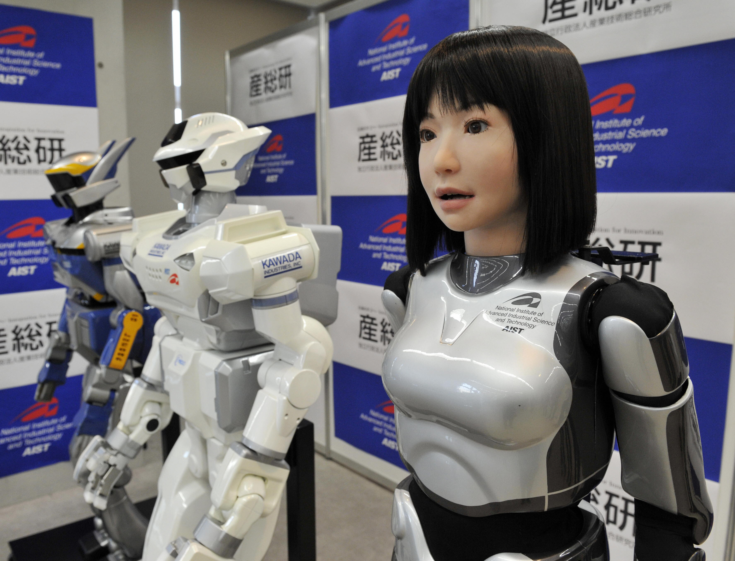
AVOID THE UNCANNY VALLEY
The concept, from robotics professor Masahiro Mori, suggests that humanoid objects which appear almost, but not exactly, like real human beings elicit uncanny, or strangely familiar, feelings of eeriness and revulsion in observers.
Mori, M (2012) [1970]. "The uncanny valley". IEEE Robotics & Automation Magazine. 19 (2): 98–100.

Slide 18

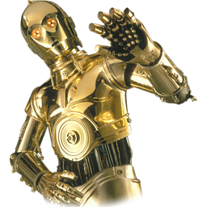
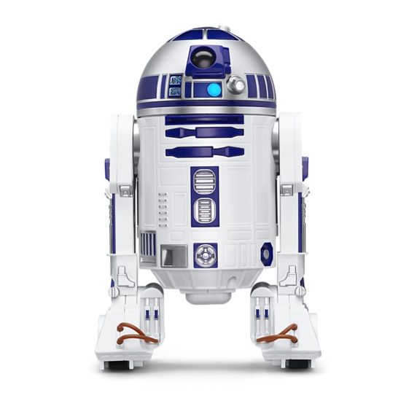
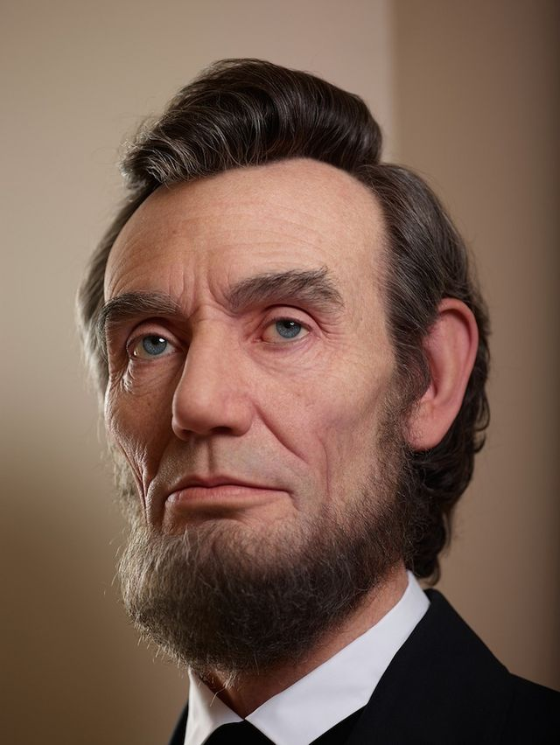
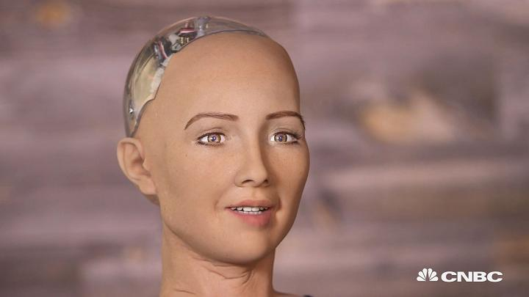

Uncanny valley
{
UNCANNY VALLEY
+
Healthy Person
Industrial robot
Humanoid Robot
FAMILIARITY
Moving
Still
Cartoon Chatbot
HUMAN LIKENESS
Alexa
-
Notes:
Mori, M (2012) [1970]. "The uncanny valley". IEEE Robotics & Automation Magazine. 19 (2): 98–100.

Slide 19
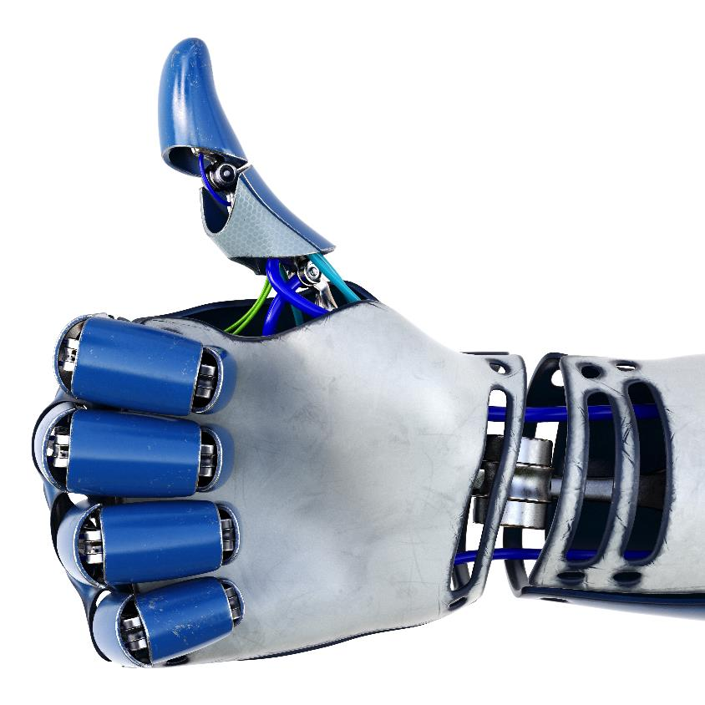
Human & bot: brand relationship
YOU’LL LIKELY BE MORE SUCCESSFUL WHEN THE TECH:
IS LIKEABLE
DEMONSTRATES
EXPERTISE
IS REASONABLE
IS EASILY
UNDERSTOOD
IS TRUSTWORTHY
RESPECTS YOU
AND YOUR TIME
BOTS NEED TO HAVE PERSONALITY and brand awareness!
Notes:
Reeves, B. & Nass, C. (2003). The media equation: how people treat computers, television and new media like real people and places: University of Chicago Press: New Ed. Edition.

Slide 20
Module 5: starting the conversation& SOLUTIONING

Slide 21
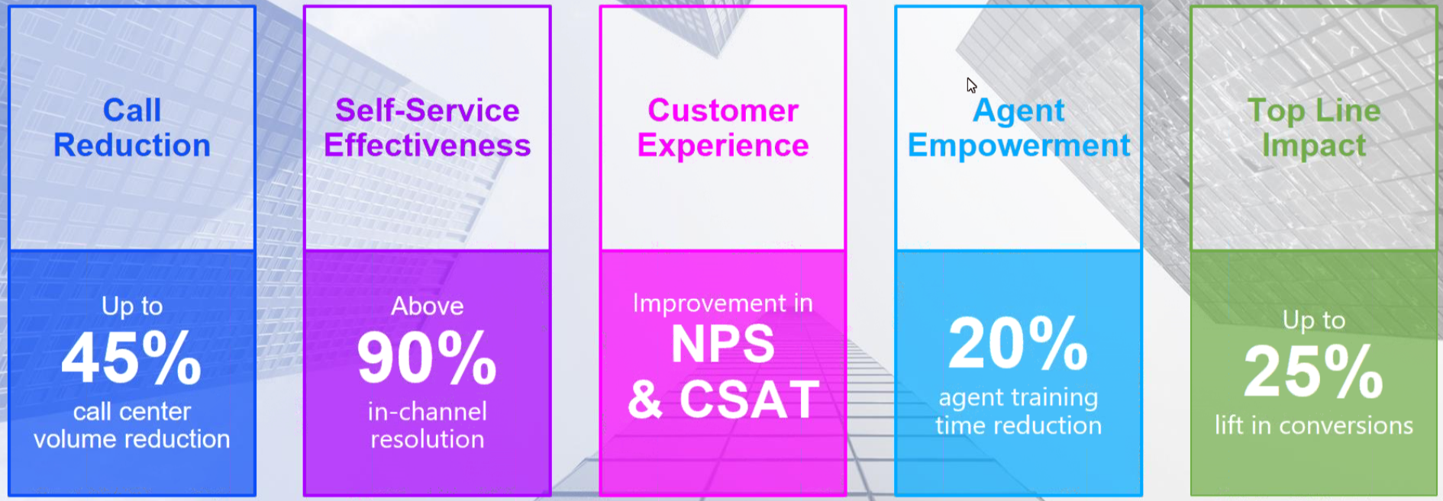
Top Benefits - example
Notes:
From our work with the NanoRep solution

Slide 22
Functional considerations
Theme | Considerations | Requirements | Complexity
Channel | Voice Channel | Speech<-to->text service; IVR integration, Connect | Medium to High
Channel | Email Channel | Email SMPT integration | Low
Channel | Website/Responsive Webapp | JavaScript Custom Widget with branding | Low to Medium
Channel | SMS Text | Twillio, Authy | Medium
Channel | Alexa, Facebook, Wechat, Slack | AWS, Google, Facebook | Medium
Knowledge | Question-answer | Information retrieval, machine learning | Low
Knowledge | Ontologies, taxonomies, workflows | Knowledge graph, graph database | Low to Medium
Knowledge | Business rules | Rules engine, inference engine | Medium to High
Knowledge | Knowledge document | Knowledge management integration, information retrieval | Low
Knowledge | User-submitted data | Frames | Low
Knowledge | Existing Knowledge Base Gathered | Structured/Unstructured | Low to Med
Knowledge | Volume of business/Transcations | Database size / User Volumes | Low to High
Knowledge | Open or Closed Domain | Closed question domain, known audience | Low to High
Work | Tiering, escalations | Live chat handoff and interface for agents | High
Work | Performance Monitoring (Control) | High reliability required, SLA’s, QoS | Low to High
Work | Internal or Consumer Facing | High Gloss External Customer or internal delivery only | Low to High
Work | Next Best Action | Read or Write Database operations | Low to Medium
Work | Language Support | English Only, Top 5 to Afrikaans | Low to Hard
Work | Personalization | Sentiment Analysis, Recognition | Medium to High

Slide 23
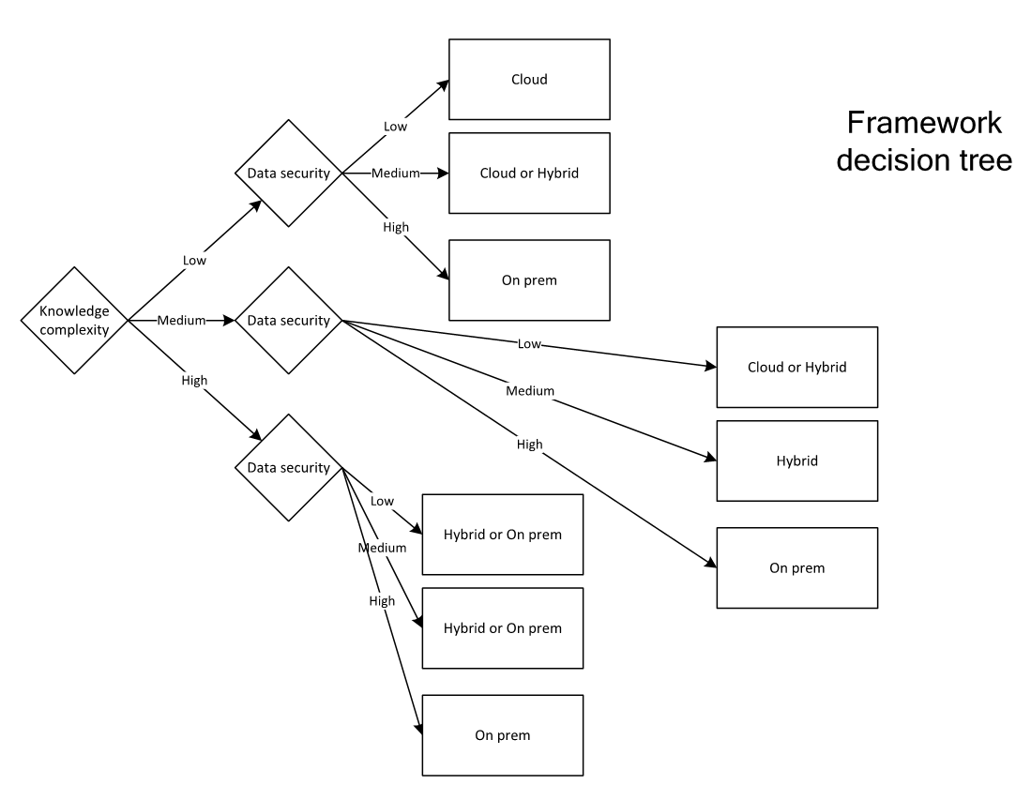
Technology considerations
Knowledge Complexity | About | Technologies
Low | FAQ | Q&A Pairs
Medium | General Domain FAQ, Help and Support | Index, Search and Retrieval
High | Specific Domain Expertise and Reasoning | Algorithms, Rules Engines, Models, Multiple Sources, Multiple Transactions
Data Security | About | Data Types
Low | Unrestricted, Confidential | Q&A Pairs, Internal documents, Social
Medium | Customer Data (Highly Confidential) | IP, ERP Integrations
High | PII, financial data (Restricted) | Full Health, Personal and Financial Records

Slide 24
Recommended technology solutions
Cloud |  | Hybrid |  | On Premise
Build | Buy | Build | Buy | Build | Buy
DialogFlow | Nanorep | DialogFlow | Kore.ai | Botkit | Kore.ai
 |  | “Agent Assist” | Nanorep | “Agent Assist”
Cloud:
Nanorep
Dialogflow
----------------------
Microsoft
IBM
Hybrid:
Kore.ai
Nanorep
On Premise:
Kore.ai
Bot Kit
Agent Assist
If selected, will take additional time
for due diligence (security review,
costing, etc.)
Green denotes MSA in place

Slide 25
Delivery approach

Slide 26
Module 6: REFERENCE ARCHITECTURE

Slide 27

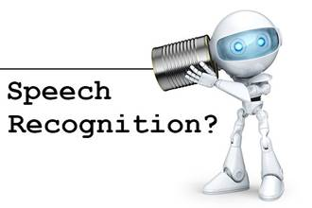




When I talk to Alexa…..
Automatic Speech
Recognition (ASA)
Natural Language
Understanding (NLU)
Natural Language
Generation (NLG)
Text to Speech (TTS)
Bot Understands
P
Bot Responds with prompts & answers**
Belief state predictor
Action planner
“What needs to happen?”
Customer
speech
Emotion
Detection
Emotion
Generation

Slide 28







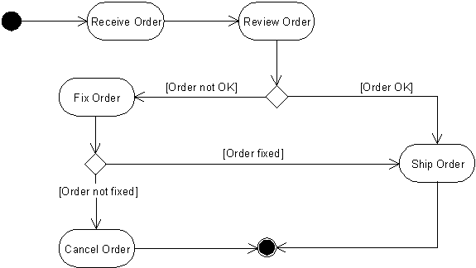
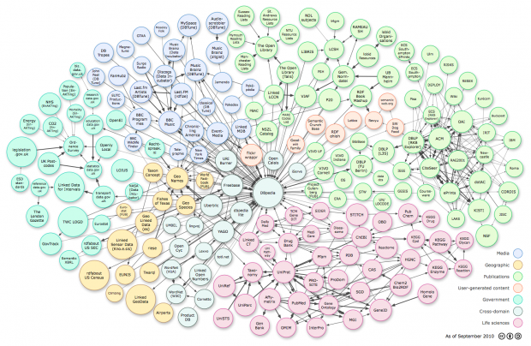
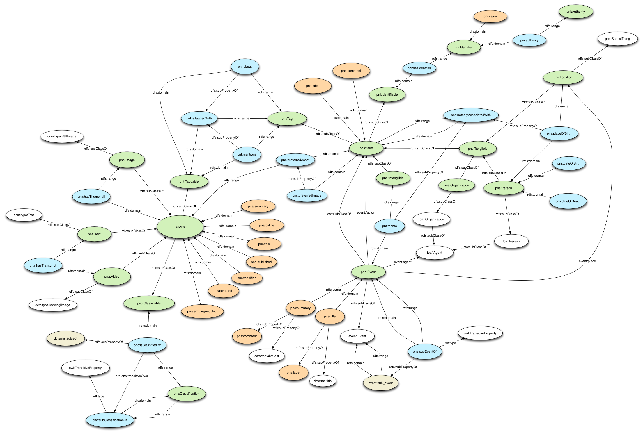
Procurement helpdesk
SELF Assist & agent assist reference architecture
Metrics and Instrumentation
(2) Transfer Learning
Solution Model
Hardware Call-home
L0
L1
L2
Continuous handoff from Agent Assist to Self Assist
Client Self-Assist
(1) Agent Assist & Curation
(3) Self Assist
Solution Architecture
Dialog
(Frame based, Rule based, Data Driven)
Information Retrieval
Information Extraction
Topic Classification
Model Based Reasoning
Hypothesis Generation
Knowledge Substrate
System/Software Models
(e.g. Behavior Models, Architecture)
Ontologies/Dictionary
Knowledge Graph
Data
Publicly available data, curated knowledge-sources and training data.
Private un-sanitized data-sources
Instrumentation Logs

Slide 29
Self assist reference architecture
A system to provide interface between the user and a computer-based application
Interact on turn-by-turn basis
Decision Tree
System Behavior Models
Knowledge Graphs
Information Retrieval
Curated QA pairs
Symbolic Reasoning Engine
Dialog Manager
Speech
Belief state Predictor
Action Planner
ASR
NLU (Intent/Slot/Domain)
NLG
Prompts, Answers
TTS
Emotion Detection
Emotion
Generation
Dialogue manager: Control the flow of the dialogue
information gathering from user
communicating with external application
communicating information back to the user
Three types of dialogue system
finite state- (or graph-) based
frame-based
agent-based

Slide 30

Agent assist reference architecture
Speech Recognition
(SmartOperator)
Explicit Agent Input
Dynamic Context Augmentation
(order #, customer #..)
CRM/ Backend
update
Knowledge Graph
Static Context Augmentation
Rules
Decision Tree
Intent Classification
(using paraphrase group)
Drool Rule Engine
Generate FAQ Answer
FACT
QA Pair
Knowledge Repository
Information Retrieval Engine
(Solr, Elastic Search)
Top K results

Slide 31
Common knowledge substrate
Knowledge Substrate API (for query or reasoning)
Facts
Knowledge Base
Orchestration Engine
Query expansion & augmentation
Hypothesis Generation & Planning
Knowledge Sources
Behavior Models
(e.g. Process Models)
BPM/RPA Engine
Reasoning Engine
Drool Inferencing Engine
Inferencing rules
Traditional Data Sources
GraphDB / Spatial
Engine
Structure Models
(e.g. vendor network, Map)
Knowledge Models
Knowledge Capturing
Non-traditional Data Sources
Concept
Models
ML
Models
GraphDB
Engine
ML
Engine

